Slide 1
Lecture 13: Chaining

Slide 2
Behavior Chain
A specific sequence of stimuli and responses
Each behavior produces a stimulus (i.e., a change in the environment through our senses) that serves as a reinforcer for that response and an SD (discriminative stimulus) or CUE for the next behavior in the chain to occur
Individual behaviors (so they look different from each other) that are linked together to form a terminal behavior

Slide 3
Behavior Chains and Limited Hold
A sequence of behaviors that must be performed correctly and within a specified time to produce reinforcement
Emphasizes both accuracy and proficiency

Slide 4
Chaining
In chaining we use a task analysis –
Where we break down the skill into smaller, teachable units
Identification of all stimuli (S^{D}s) and responses (Rs)
Notes:
Task Analysis
An analysis of complex behavior
and sequences of behavior
into their component parts

Slide 5
Chaining
Example: Eating a bowl of oatmeal
(S^{D}1) bowl of oatmeal, spoon in hand ---> (R1) put spoon in food
(S^{D}2) spoon in food -----> (R2) scoop food onto spoon
(S^{D}3) food on spoon ----> (R3) Put food in mouth ----> (S^{R}) eat
Notes:
Task Analysis
An analysis of complex behavior
and sequences of behavior
into their component parts

Slide 6
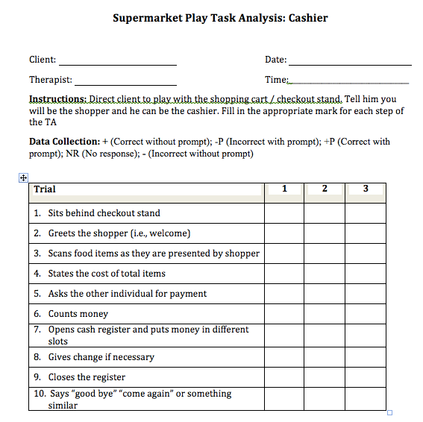

Slide 7
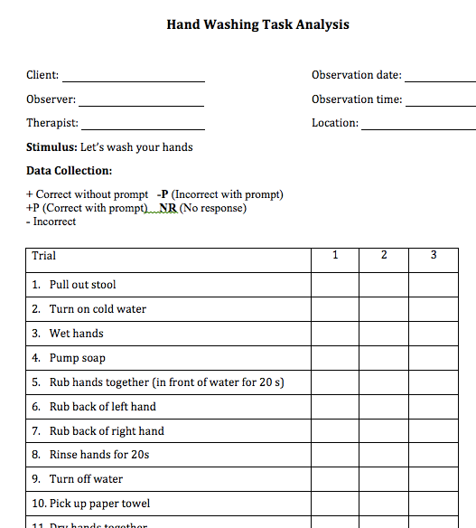

Slide 8
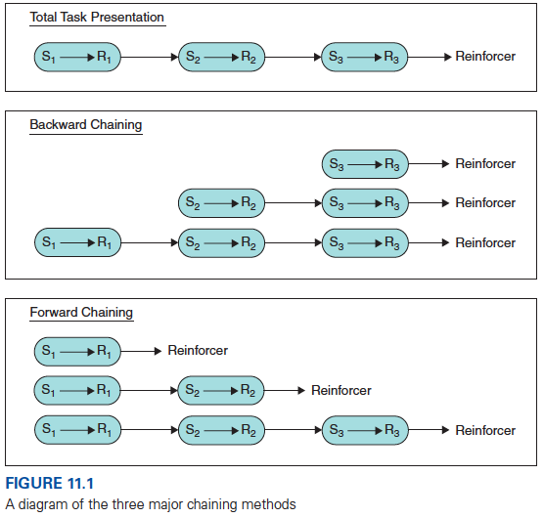
Chaining
Total Task Presentation
Attempt all steps of the chain
Continue until every step is mastered
Prompting provided as needed
Reinforcement provided upon completing last step

Slide 9
Chaining
Total Task Presentation
Attempt all steps of the chain
Continue until every step is mastered
Prompting provided as needed
Reinforcement provided upon completing last step

Slide 10
Chaining
Backward Chaining
Last step first
Then, next-to-the last step is taught and linked with last step
On each trial, last step in the chain is reinforced

Slide 11
Chaining
Forward Chaining
Initial step first
Then, first and second… etc.
On each trial, last step that was developed is reinforced

Slide 13
How to decide on the type of chaining to use
Depends on the number of steps that can be completed independently by the learner during the initial task analysis
Physical abilities of the learner
Cognitive levels
*HOWEVER, THESE ARE JUST TIPS→ NO CLEAR ANSWER TO THIS QUESTION

Slide 14
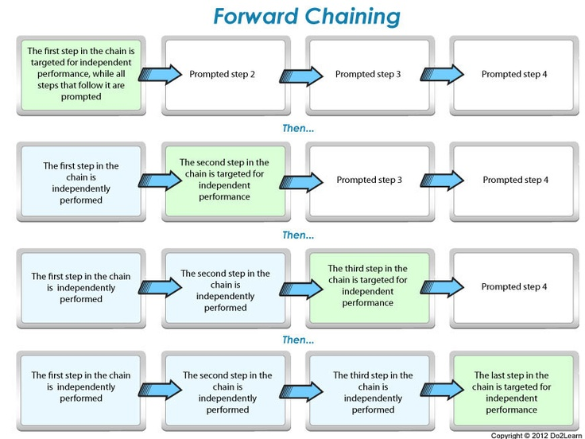

Slide 18
Which procedure to use?
No data to indicate one is more effective than another
Choose total-task chaining if
Learner knows many of the tasks but needs to learn how to do them in sequence
Has an imitative repertoire
Has moderate to severe disabilities
Task is not long or complex

Slide 19
Influencing the Effectiveness of Chaining
Can we use strategies for independent learners?
E.g., written task analysis, picture prompts
Begin teaching the behavior chain
Give instructions to begin work
Start with appropriate step for the type of chaining method used
If learner makes a mistake, use error correction
Provide necessary instruction or physical guidance
After error corrected, move to next step

Slide 20
Behavior Chain Interruption Strategy (BCIS)
Chain is interrupted at a predetermined step so that another behavior can be emitted
Interruption may cause some distress
It momentarily blocks access to reinforcement
This is somewhat desirable because it creates motivation to learn the new behavior in the chain
As long as it is not so distressful that it causes emotional responding or self-injurious behavior

Slide 21
Shaping vs. Chaining
 | Shaping | Chaining
Several distinctly different responses (response classes) | No | Yes
Behavior changes along a single response dimension (e.g., force) | Yes | No
Skinner Box Example | Increasing the force of the lever press | Walking toward the lever, pressing the lever, approaching the food

Slide 22

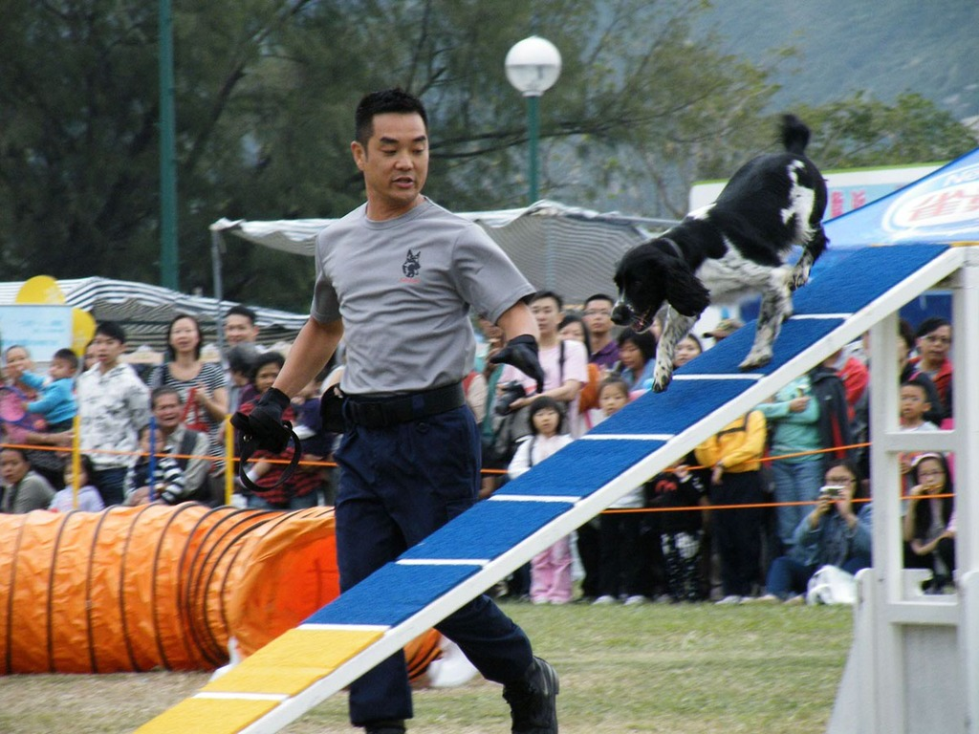
Shaping vs. Behavioral Chaining
THEY ARE NOT THE SAME!
Shaping– using differential reinforcement procedures for the same response (i.e. pushing lever down) where we gradually change the requirements along some response dimension (like the force of the lever)
Notes:
D-06. Use chaining

Slide 23
Shaping vs. Behavioral Chaining
Chaining – when we are working with a sequence of distinctly different responses (like steps for approaching and pressing the lever)
Notes:
D-06. Use chaining

